Slide 1
What is Git & why it’s important

Slide 2
What is Git?
Git is a distributed version control system used to track changes in source code. It allows developers to collaborate efficiently, maintaining a full history of all changes. Git supports branching and merging, enabling multiple features or experiments to be developed in parallel. Every developer has a full copy of the repository, making it resilient and reliable.
Key Features of Git
Version Tracking: Every change is recorded and can be reverted if needed.
Branching & Merging: Safe experimentation without affecting the main codebase.
Collaboration: Multiple developers can work simultaneously without conflicts.
Distributed System: Local copies allow offline work and reduce dependency on a central server.
History & Accountability: Maintains a detailed log of who made changes and why.

Slide 3
Why Git is Important?
Collaboration: Essential for team projects, allowing multiple developers to work together seamlessly.
Backup & Recovery: Complete history allows rollback to previous versions in case of mistakes.
Code Quality & Integrity: Tracks changes and helps enforce code reviews.
Efficiency: Branching and merging reduce development conflicts and streamline workflows.
Integration: Works with platforms like GitHub, GitLab, and Bitbucket for CI/CD, issue tracking, and project management.

Slide 4
Git in Real-World Use
Open-Source Projects: Used in projects like Linux, Python, and React for version control and collaboration.
Team Collaboration: Allows multiple developers to work on the same project simultaneously without conflicts.
Continuous Integration & Deployment (CI/CD): Integrates with pipelines to automate testing, building, and deployment.
Code Review & Quality Control: Supports pull requests and reviews to maintain high code quality.
Backup & Recovery: Full history of code allows rollback to previous versions in case of mistakes.
Project Management Integration: Works with GitHub, GitLab, and Bitbucket for issue tracking and task management.
Scalability: Handles small projects as well as large-scale enterprise applications efficiently.

Slide 5
Basic Git workflow

Slide 6
Basic Git Workflow
The Git workflow defines the standard process developers follow to manage changes in a project.
Understanding the workflow ensures organized, trackable, and safe development.
Core steps include initializing a repository, staging changes, committing, and checking the status.
Git Workflow Commands
Working Directory - Where you make changes
git add - Stage changes
git commit - Save changes to your repository
git push - Share changes with others
git status - Check what's going on
Undo/Amend - Fix mistakes (git restore, git reset, git commit --amend)

Slide 7
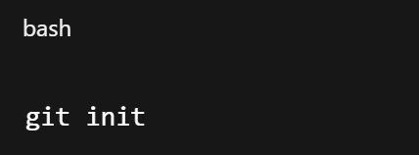
*git init – initialize repo.
git init is used to initialize a new Git repository in a project directory.
It creates a hidden .git folder that tracks changes in the project.
After initialization, Git can track files, commits, and branches.
Example :
Use this when starting a new project or converting an existing project to Git.

Slide 8
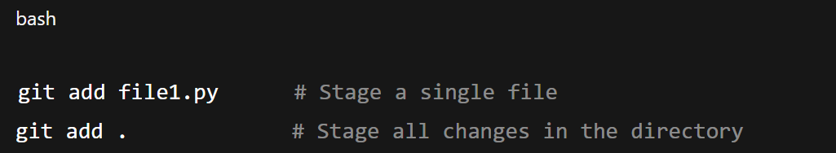
*git add – stage changes
git add is used to stage changes before committing them.
Only staged files are included in the next commit.
Can stage a single file or all modified files.
Example :
Staging allows selective commits and avoids committing unnecessary changes.

Slide 9
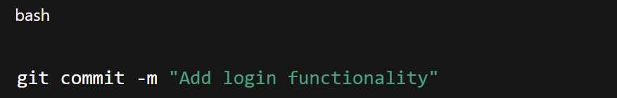
*git commit – save changes with a message
git commit saves the staged changes to the repository with a descriptive message.
Commits represent a snapshot of the project at a point in time.
Good commit messages make it easy to understand changes later.
Example :
Commit often to maintain granular and organized history.

Slide 10
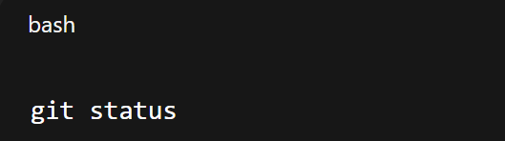
*git status – check current state
git status shows the current state of the repository.
Displays:
Staged changes
Unstaged changes
Untracked files
Helps developers verify what has been added or modified before committing.
Example :
A key command to avoid mistakes and maintain a clean workflow.

Slide 11
Summary of Basic Workflow
Initialize Repository: git init
Stage Changes: git add <file> or git add
Commit Changes: git commit -m "message“
Check Status: git status
This workflow ensures organized version control, easy collaboration, and a complete project history.

Slide 12
Remote Repositories
(GitHub/GitLab/Bitbucket)

Slide 13
What are Remote Repositories?
Remote repositories are central locations where code and other files managed by Git are stored, enabling collaboration among multiple developers and serving as a backup. Unlike local repositories, which reside on an individual's machine, remote repositories are typically hosted on cloud-based platforms or internal servers.
Popular Remote Repository Hosting Services:
GitHub: A widely used platform known for its social coding features, extensive open-source community, and integrations with various development tools.
GitLab: Offers a comprehensive DevOps platform, including not only Git hosting but also CI/CD, project management, and security features. It can be hosted in the cloud or on-premise.
Bitbucket: Developed by Atlassian, it integrates seamlessly with other Atlassian products like Jira and Confluence, making it a popular choice for teams already using the Atlassian ecosystem.

Slide 14
Key Functions of Remote Repositories
Collaboration: Multiple developers can share code by pushing and pulling changes.
Version Control: Stores complete history, enabling rollback and tracking modifications.
Backup: Acts as a safeguard against local data loss.
Code Review & Management: Supports reviews, issue tracking, and project management.

Slide 15

*git clone – copy a repo
git push is used to upload local commits to the remote repository.
Keeps the remote repo updated with the latest work.
Typically pushes to the main or feature branch.
Example :
Ensures team members can see and use your latest changes.

Slide 16

*git pull – Fetch & Merge Updates from Remote
git pull is used to download and merge changes from the remote repository into the local repo.
Keeps your local project in sync with team updates.
Equivalent to running git fetch + git merge.
Example :
Prevents conflicts and ensures your work is based on the latest code.

Slide 17

*git push – Send Local Changes to Remote
git push is used to upload local commits to the remote repository.
Keeps the remote repo updated with the latest work.
Typically pushes to the main or feature branch.
Example :
Ensures team members can see and use your latest changes.

Slide 18
Summary of Basic Workflow
Clone Project: git clone to copy a repository.
Push Changes: git push to share your work with the team.
Pull Updates: git pull to stay updated with others’ changes.
Remote repositories ensure collaboration, synchronization, and backup in modern software engineering.

Slide 19
Branching & Merging

Slide 20
Git Branching & Merging
Branching allows developers to work on features or fixes independently without affecting the main codebase.
Merging integrates the changes from one branch back into another (usually into main/master).
This workflow makes experimentation and teamwork safe and efficient.
Key Functions of Branching & Merging
Collaboration: Multiple developers can share code by pushing and pulling changes.
Version Control: Stores complete history, enabling rollback and tracking modifications.
Backup: Acts as a safeguard against local data loss.
Code Review & Management: Supports reviews, issue tracking, and project management.

Slide 21

*git branch – create branch
git branch is used to create a new branch in the repository.
A branch is like a parallel workspace for new features or fixes.
Example :
Keeps work isolated from the main project until it’s ready.

Slide 22
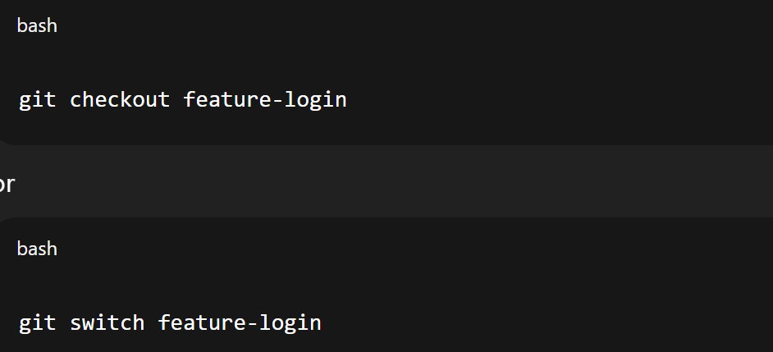
*git checkout / git switch – Move Between Branches
git checkout or git switch lets you move between branches.
You can switch to an existing branch to continue work.
Example :
Ensures you are working in the correct branch.

Slide 23
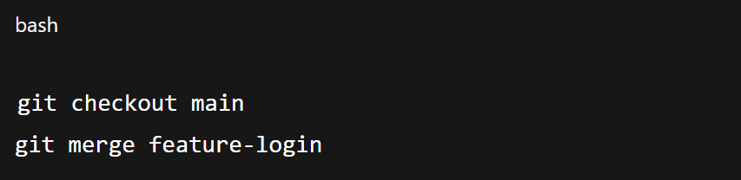
*git merge – Combine Work
git merge is used to combine changes from one branch into another.
Typically used to merge feature branches back into the main branch.
Example :
Integrates work while preserving history.

Slide 24
Benefits of Branching & Merging
Enables parallel development by different team members.
Supports safe experimentation without affecting the stable version.
Simplifies feature integration and bug fixes.
Encourages clean and organized workflows.

Slide 25
Git Commit Message

Slide 26
What are Git Commit Messages?
Commit messages are the written record of every change made in a project’s codebase. They act like a logbook that explains not just what was changed, but often why. Writing meaningful commit messages helps both the individual developer and the entire team by providing context, improving code traceability, and supporting smoother collaboration in the long run.
Why Commit Messages Matter?
Help developers understand the purpose of changes.
Make it easier to track bugs and fixes later.
Improve team communication in large projects.
Provide context when reviewing past changes.

Slide 27
Best Practices for Writing Commit Messages
Start with a short summary line (50–72 characters max) that explains the change at a glance, making it easy to scan through history.
Use imperative mood in the subject line, e.g., “Add login validation” instead of “Added” or “Adding.” This is a convention that aligns commit messages with commands.
Capitalize the first letter of the summary for consistency and readability.
Avoid vague words like “fix,” “update,” or “changes” without context. Instead, specify what was fixed or updated.
Provide a detailed description in the body (if needed) to explain why the change was made, possible impacts, or alternatives considered.
Separate subject and body with a blank line for proper formatting in Git.
Reference issue/task IDs (e.g., Fix #321 or JIRA-456) when integrating with project management tools so that commits link directly to tasks.
Keep commits atomic: one commit should represent one logical change, making history easier to navigate and revert if necessary.

Slide 28
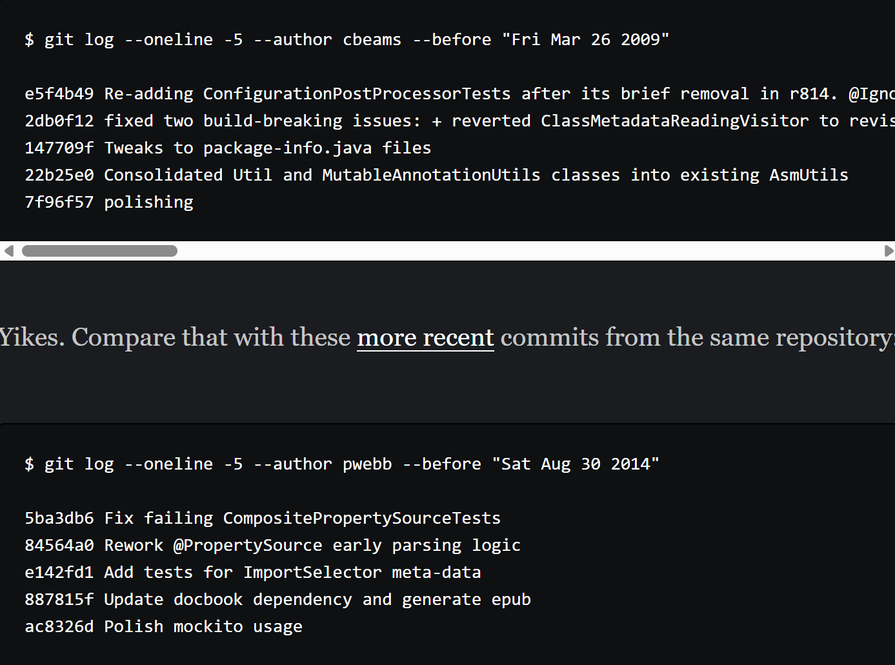
Example
Bad Commit Message
Which would you rather read?
The 1st one varies in length and form
The 2nd one is concise and consistent.
Obviously, 2nd one because its clean and understandable
Good Commit Message

Slide 29
Commit often, push regularly

Slide 30
What Commit often, push regularly mean?
In Git, commits and pushes are the foundation of tracking and sharing progress. Following the practice of committing often and pushing regularly ensures that development work is well-documented, safe, and collaborative.

Slide 31
Commit Often
Committing often means breaking work into small, logical chunks and recording them frequently.
Each commit should represent a clear and meaningful change (e.g., fixing a bug, adding a feature, or updating documentation).
Frequent commits make it easier to understand project history, isolate issues, and roll back if something goes wrong.
This approach encourages incremental progress instead of large, risky changes.

Slide 32
Push Regularly
Pushing regularly ensures your commits are shared with the remote repository so teammates can access your latest work.
Regular pushes reduce the chance of merge conflicts, since everyone’s changes stay in sync.
Frequent synchronization acts as a backup, protecting against data loss if your local system fails.
Teams benefit from faster collaboration, as work is visible and reviewable in real time.

Slide 33
Benefits of This Practice
Improves Collaboration: Keeps all team members aligned and updated.
Ensures Safety: Local changes are backed up on the remote server.
Speeds Up Reviews: Smaller, frequent commits are easier to review.
Reduces Errors: Minimizes large conflicts by integrating changes early.
Supports Agility: Encourages small, iterative progress consistent with Agile principles.

Slide 34
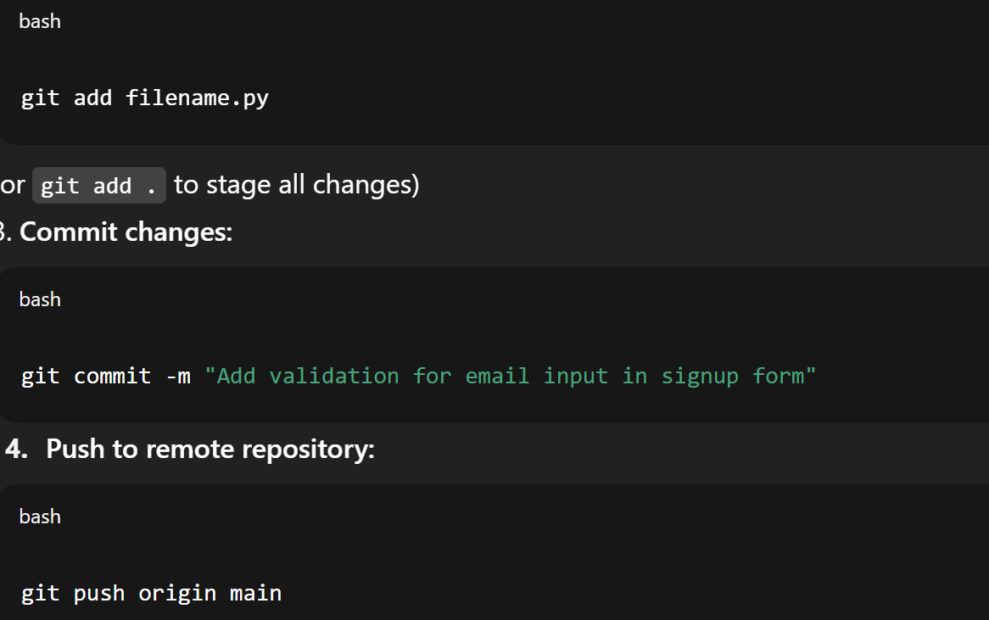
Example Workflow
Step 1 - Make changes in your code (fix a bug, add a feature, update docs).
Step 2 - Stage changes:
Tip: Repeat this cycle frequently—small commits and regular pushes keep your project history clean, organized, and collaborative.
Step 3 - Commit changes:
Step 4 - Push to remote repository:

Slide 35
Keep main branch stable

Slide 36
What Keep main branch stable mean?
The main branch (also called master in some projects) is the backbone of a Git repository. It represents the most stable and production-ready version of the software. Keeping this branch stable ensures that users and developers can always rely on it as the source of truth.

Slide 37
Why Stability Matters?
The main branch is often deployed to production, so any instability can affect real users.
A stable branch gives teams a safe baseline to work from.
It reduces the risk of introducing critical bugs into production.
Ensures continuous delivery pipelines can run smoothly without failures.

Slide 38
How to Keep Main Branch Stable?
Use feature branches for new work instead of committing directly to main.
Merge changes into main only after code review and testing.
Apply pull requests (PRs) or merge requests (MRs) as gates for quality control.
Use continuous integration (CI) pipelines to automatically run tests before merging.
Tag stable versions with releases for tracking and rollback.

Slide 39
Benefits of a Stable Main Branch
Guarantees a working version of the software at all times.
Simplifies deployment since main is always reliable.
Builds trust in the development process, especially in team settings.
Reduces firefighting, as fewer bugs slip into production.
Supports professional, maintainable workflows aligned with Agile and DevOps practices.

Slide 40
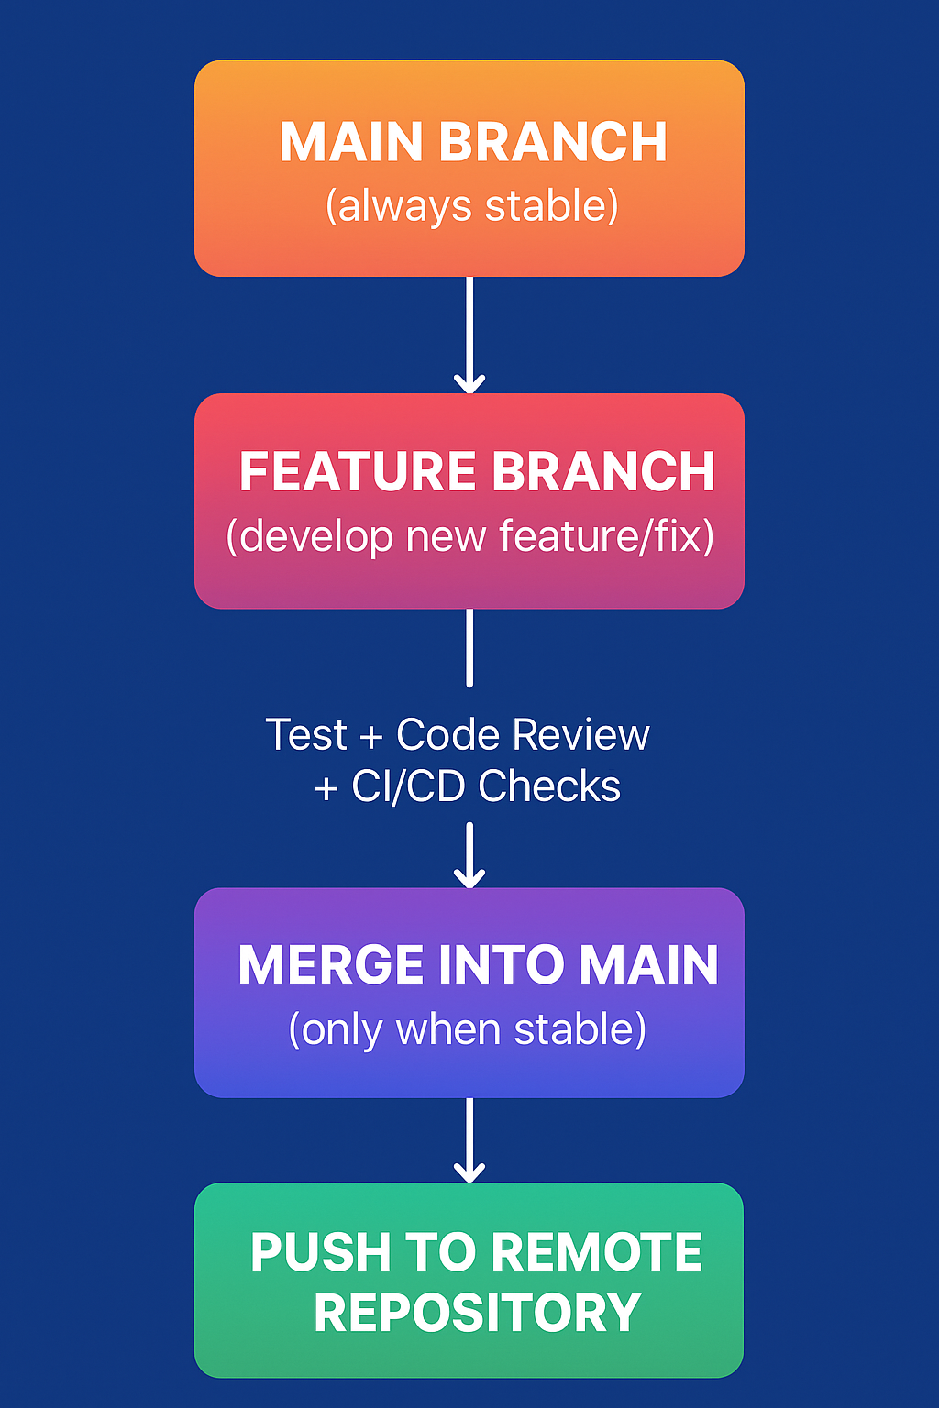
Example Workflow
Step 1: Create a feature branch for new work
Step 2: Work and commit changes on the feature branch
Step 3: Merge feature branch into main after testing & review
Step 4: Push the stable main branch to remote

